Slide 1
Python Application:
Google geocoding web service

Slide 2
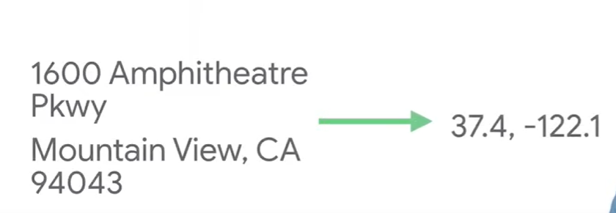
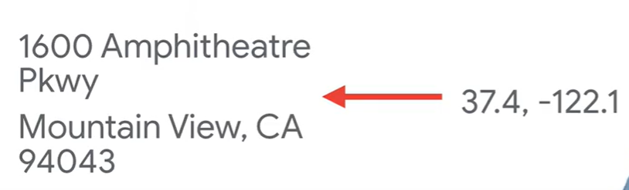
Geocoding API
A service that provides geocoding and reverse geocoding of addresses.
Geocoding
Reverse Geocoding

Slide 3
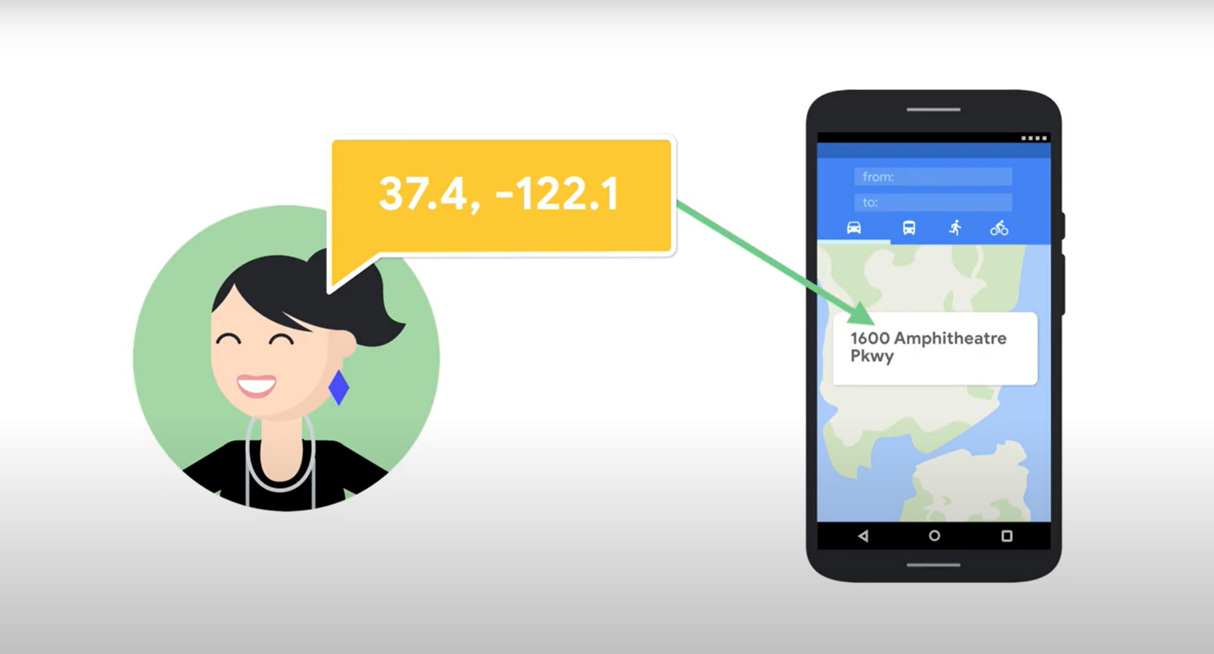
For Example
You know the latitude and longitude of the User. Using that, you can find the location of the user (Reverse Geocoding).

Slide 4
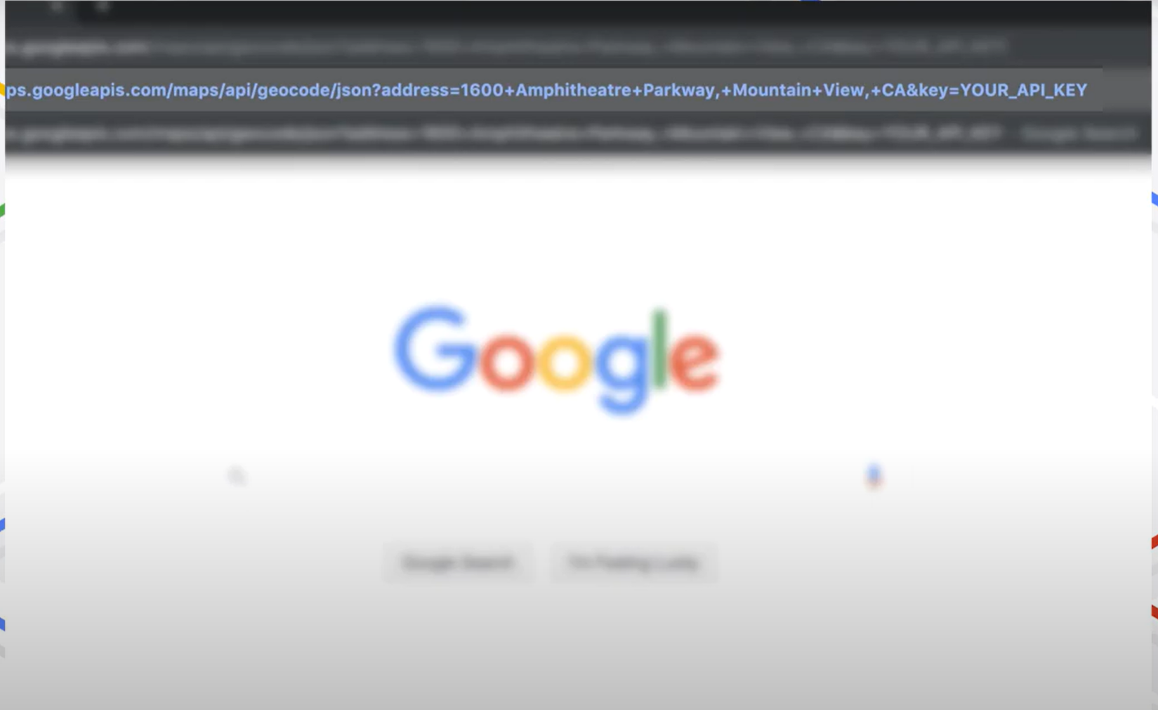
Lets' see how this works on Goggle:
Searching a location in the bar looks like https://maps.googleapis.com/maps/api/geocode/json?address=1600+Amphitheatre+parkway,+Mountain+View,+CA&key=Your_API_KEY

Slide 5
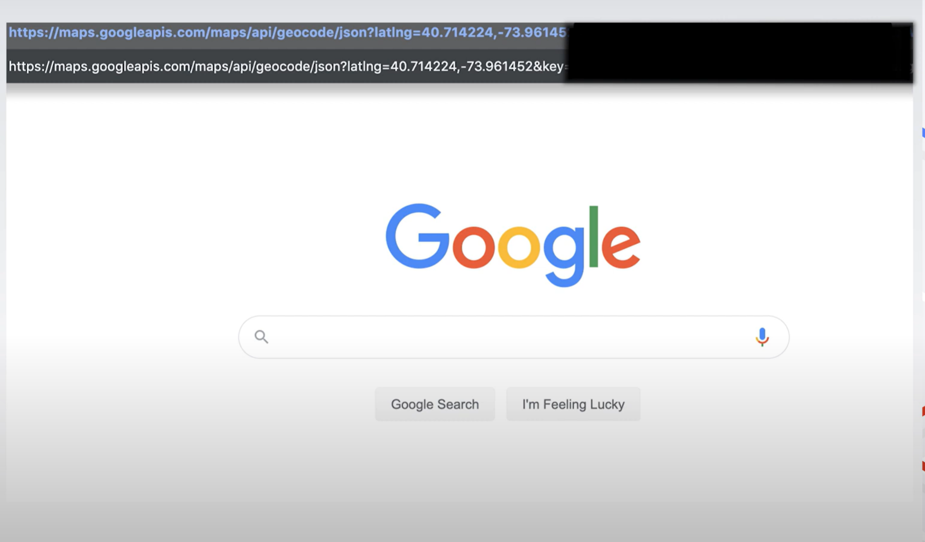
Lets' see how this works on Goggle:
Searching coordinates in the bar looks like https://maps.googleapis.com/maps/api/geocode/json?latlng=40.714224,-73.96145,+CA&key=Your_API_KEY

Slide 6
Code Behind this Geocoding API

Slide 7
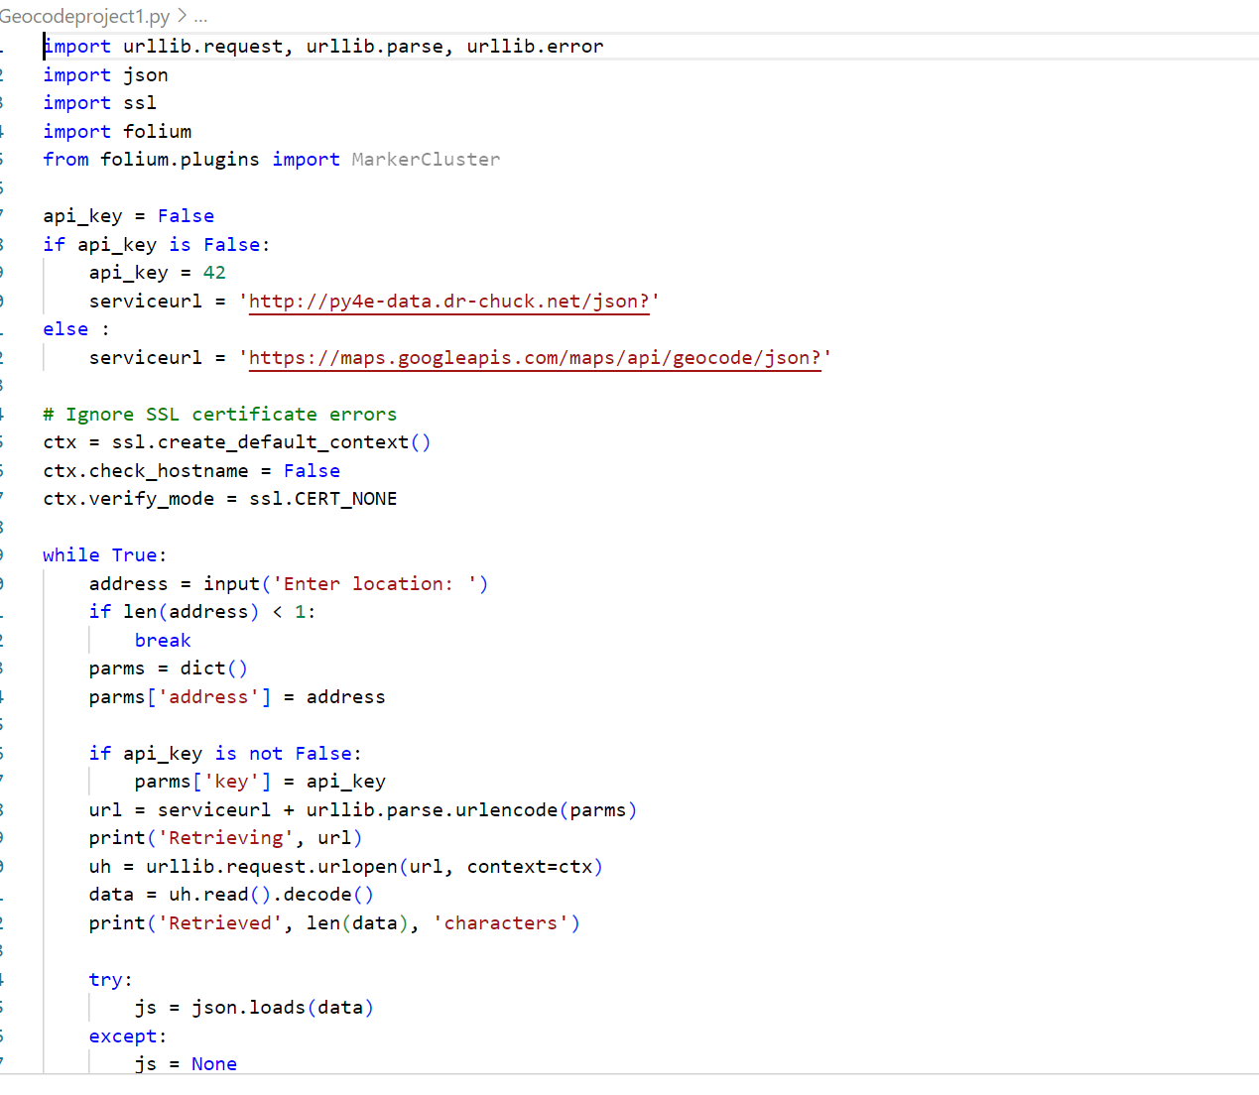
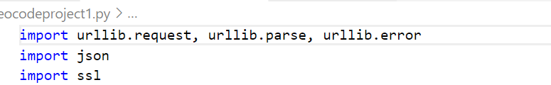
Imported Libraries
urllib : This library works with the urls. For running any application on the Internet, we need to import this library.
urllib.request : The 'request' module of urllib retrieves the webpages from the internet and performs various functions.
urllib.parse : It has two functions, one splits a URL string into its components, second combines URL components into a URL string.
urllib.error : It is used to handle excepts caused by entering invalid addresses.
Json : It is a data exchanger. It changes the requested data into desired form using JavaScript objects.
ssl : It access the secured layer of communication and undergo encryption and peer authentication for both client-side and server-side.

Slide 8
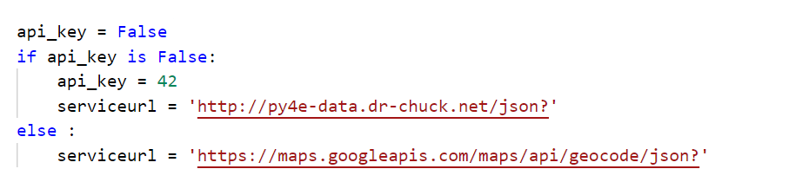
Next Code Block
api_key is a unique identifier used to identify and authenticate the user.
Using api_key=42, the user can interact with the whole intranet data, and do things such creating a new message on the forum, read users profiles, get data from the internet on a project, and more.
The serviceurl contains the geocoding address to access the free services provided by google to know the location information.

Slide 9
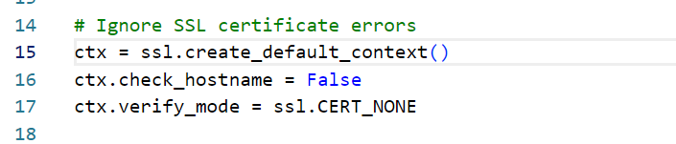
Next Code Block
The functions create_default_context() returns a new context with secure default settings.
The ssl completes the handshake with the client before starting communication. And, while doing handshake it requires client verification, check_hostname must be enabled to verify the authenticity of a certification.

Slide 10
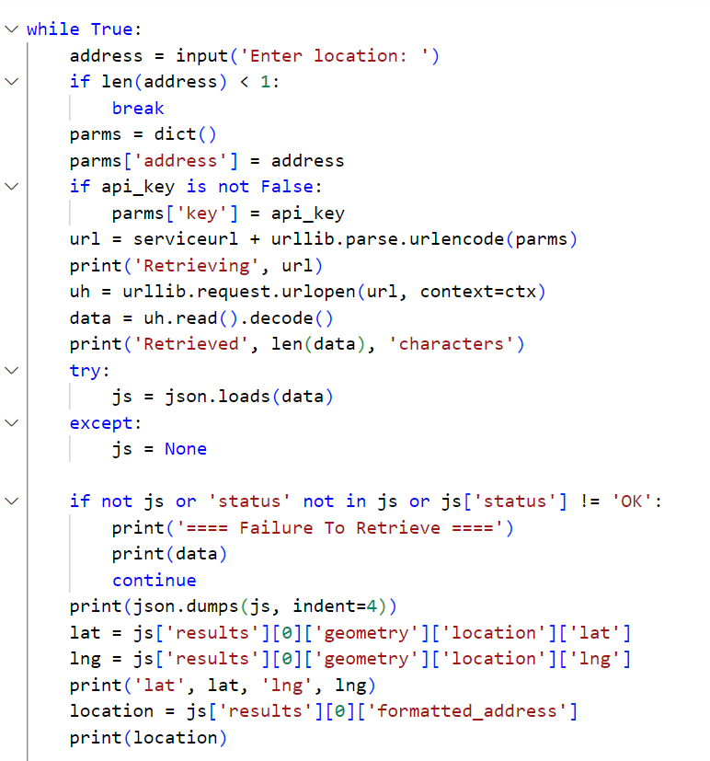
Next Code Block

Slide 11
Next Code Block

Slide 12
Next Code Block

Slide 13
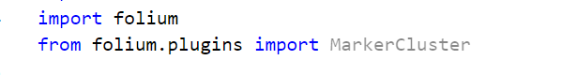
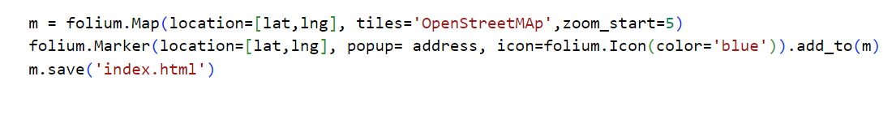
Add on: For Map Output

Slide 14
Output of the Code

Slide 15
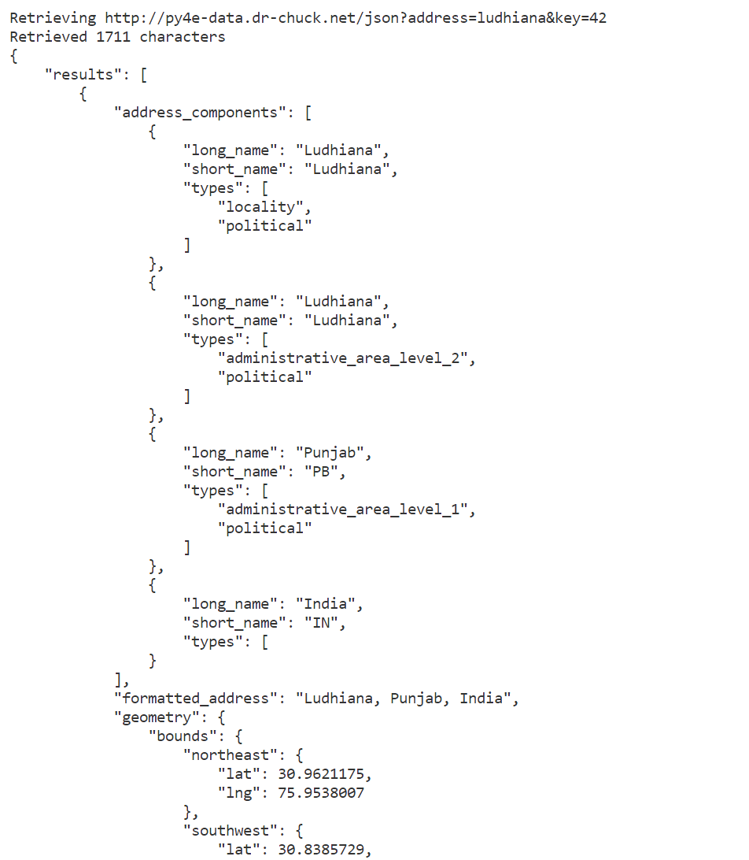
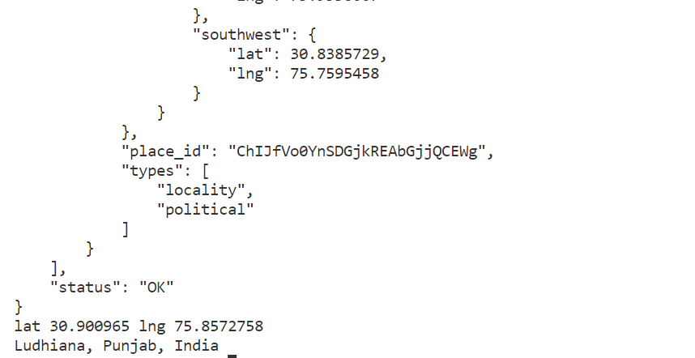
Input - Ludhiana

Slide 16
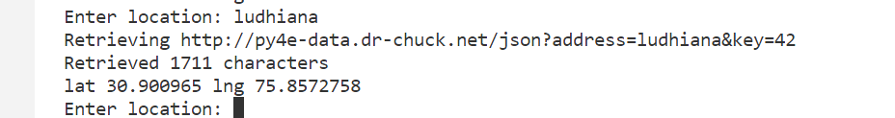
Only Printing latitiude and longitude

Slide 17
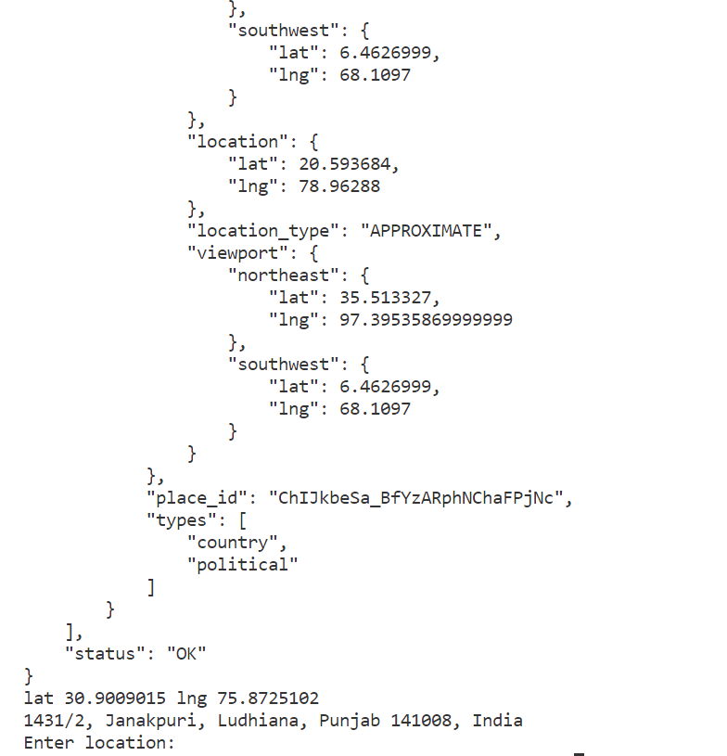
Input - 30.9009 75.85727

Slide 18
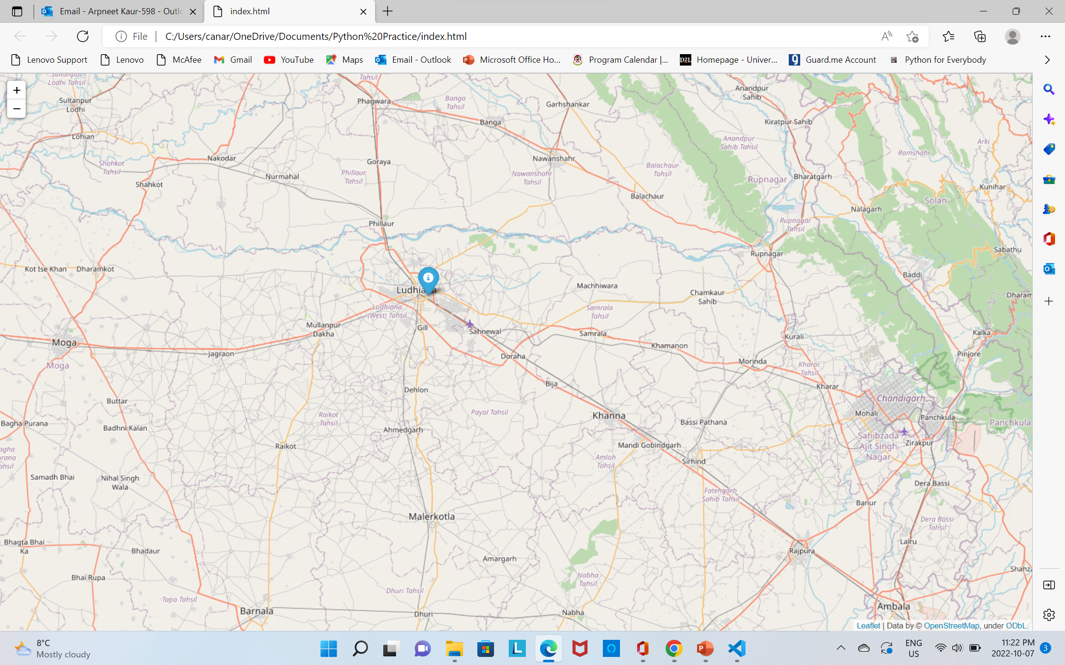
Map Output

